Slide 1

CSI-317
Theory Of Computing

Slide 2
Part-I Automata Theory

Slide 3
Regular Language

Slide 4
# Contents
Introduction of Regular Language
Closure Under The Regular Operations
Regular Expression
Formal Definition
Example of Some Regular Expression
Important Tips of Regular Expression
Application of Regular Expression

Slide 5

Introduction of Regular Language
In theoretical computer science and formal language theory, a regular language (also called a rational language) is a formal language that can be expressed using a regular expression
A regular language satisfies the following equivalent properties:
it is the language of a regular expression
it is the language accepted by a nondeterministic finite automaton (NFA)
it is the language accepted by a deterministic finite automaton (DFA)

Slide 6
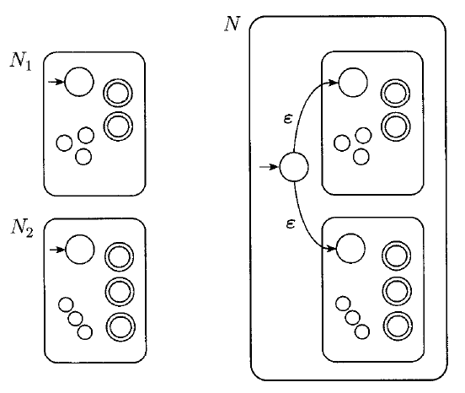
Closure Under The Regular Operations
Regular Language is closed under Union:

Slide 7
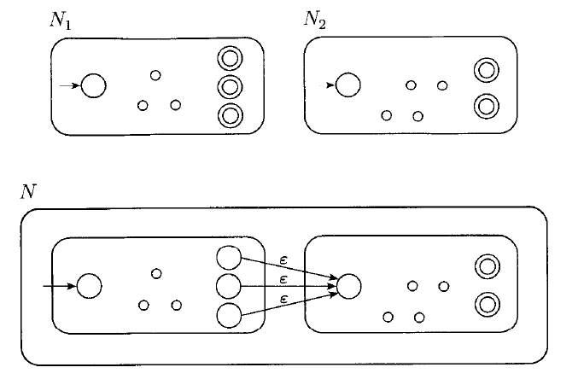
Closure Under The Regular Operations (cont.)
Regular Language is closed under Concatenation:

Slide 8
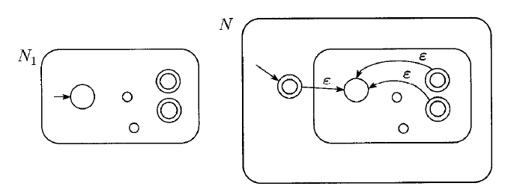
Closure Under The Regular Operations (cont.)
Regular Language is closed under star operation:

Slide 9
Regular Expression
In Arithmetic (5+3)X4, This is the value of a number.
But in reg exp this value is a language
(0 U 1)0* is read
Start with 0 or 1 followed by 0
R
R*
RR* = R⁺

Slide 10
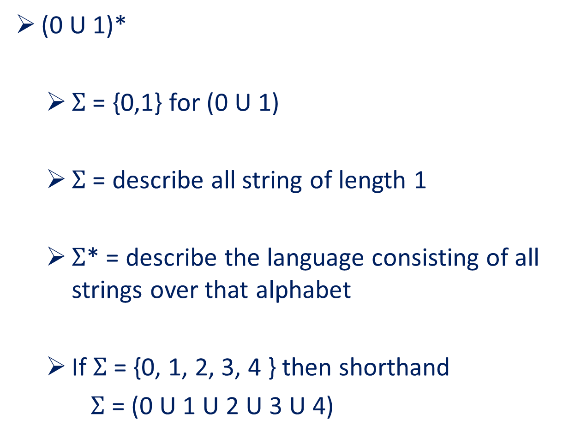
Regular Expression (cont.)
(0 U 1)*
$Σ$ = {0,1} for (0 U 1)
$Σ$ = describe all string of length 1
$Σ$* = describe the language consisting of all strings over that alphabet
If $Σ$ = {0, 1, 2, 3, 4 } then shorthand
$Σ$ = (0 U 1 U 2 U 3 U 4)

Slide 11
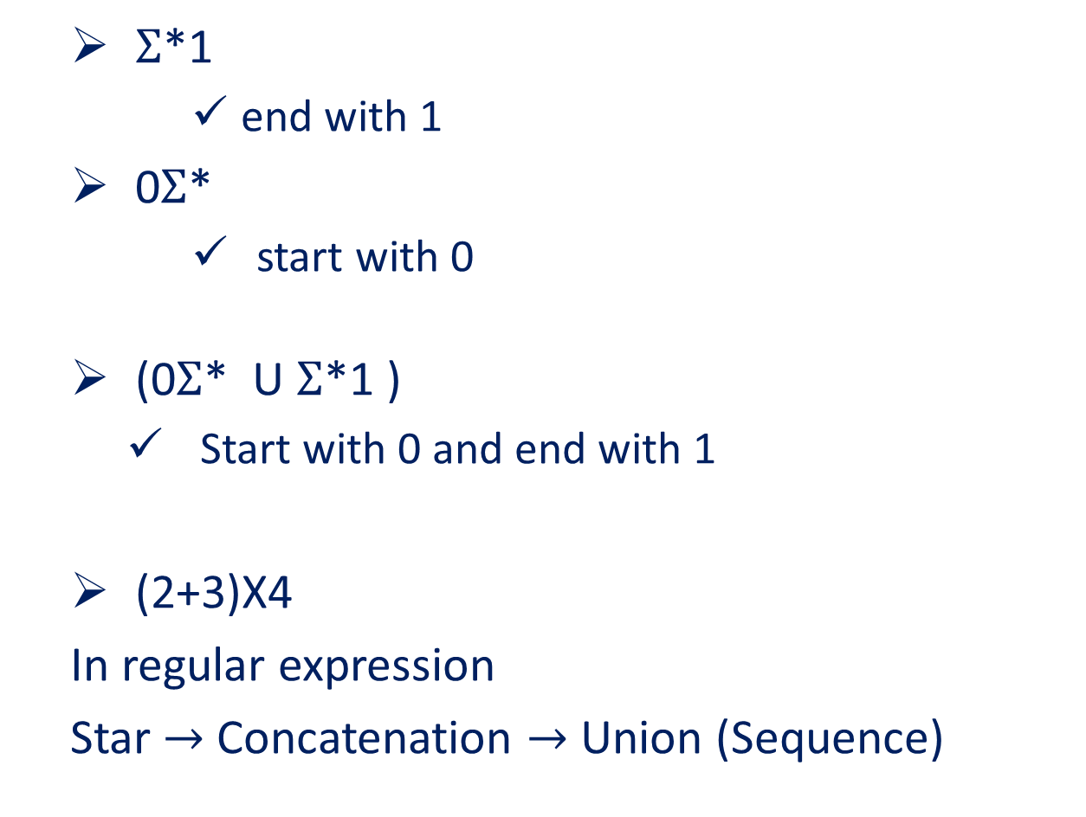
Regular Expression (cont.)
$Σ$*1
end with 1
0$Σ$*
start with 0
(0$Σ$* U $Σ$*1 )
Start with 0 and end with 1
(2+3)X4
In regular expression
Star $→$ Concatenation $→$ Union (Sequence)

Slide 12

Formal Definition
R is a regular expression if R is
a from some a in the alphabet $Σ$
$ε$
$φ$
(R₁ U R₂₎, where R₁ and R₂ are regular expression
(R₁ o R₂₎, where R₁ and R₂ are regular expression
(R₁*), where R₁ is a regular expression

Slide 13

Example of Some Regular Expression
R ⁺ $→$ RR*
R ⁺ $U$ $ε$ $→$RR*
L(R) is the language of regular expression
$Σ$ = {0,1}
0*10* = {$ω$|$ω$ contains a single 1}
$Σ$*1 $Σ$* = {$ω$|$ω$ has at least one 1}
$Σ$*001 $Σ$* = {$ω$|$ω$ contains the string 001 as a substring}
($Σ$ $Σ$)* = {$ω$|$ω$ has even length}
($Σ$ $Σ$ $Σ$)* = {$ω$|$ω$ contains strings which length is multiple of 3}

Slide 14

Example of Some Regular Expression (cont.)
01 U 10 = {01, 10}
0$Σ$*0 U 1$Σ$*1 U 0 U 1 = {$ω$|$ω$ starts or ends with the same symbol}
(01*)* = {$ω$|$ω$ every 0 in $ω$ is followed by at least one 1}
(0 U $ε$)1* = 01* U 1*
(0 U $ε$ )(1 U $ε$) = {$ε$, 0,1,01}
1* $φ$ = $φ$ (if anything is concate with $φ$ set the result will be $φ$)
$φ$*= {$ε$}

Slide 15

Some Important Tips of Reg Exp
R U $∅$ = R
R $∙$ $ε$ = R
R U $ε$ not equal to R
Ex: if R = 0 then L(R)= {0}
But if L(R U $ε$ ) = {0, $ε$}
R $∙∅$ may not equal R
Ex: if R = 0 then L(R)= {0}
But if L(R $∙∅$ ) = $∅$

Slide 16
Application of Regular Expression
Search for string or pattern
In text editors
Design of compilers for programming language
Token (ex: variable, constant can be described by regular expression)
Syntax of token once described automatic system can generates
(Lexical analyzer that first initially process the input program)

Slide 17
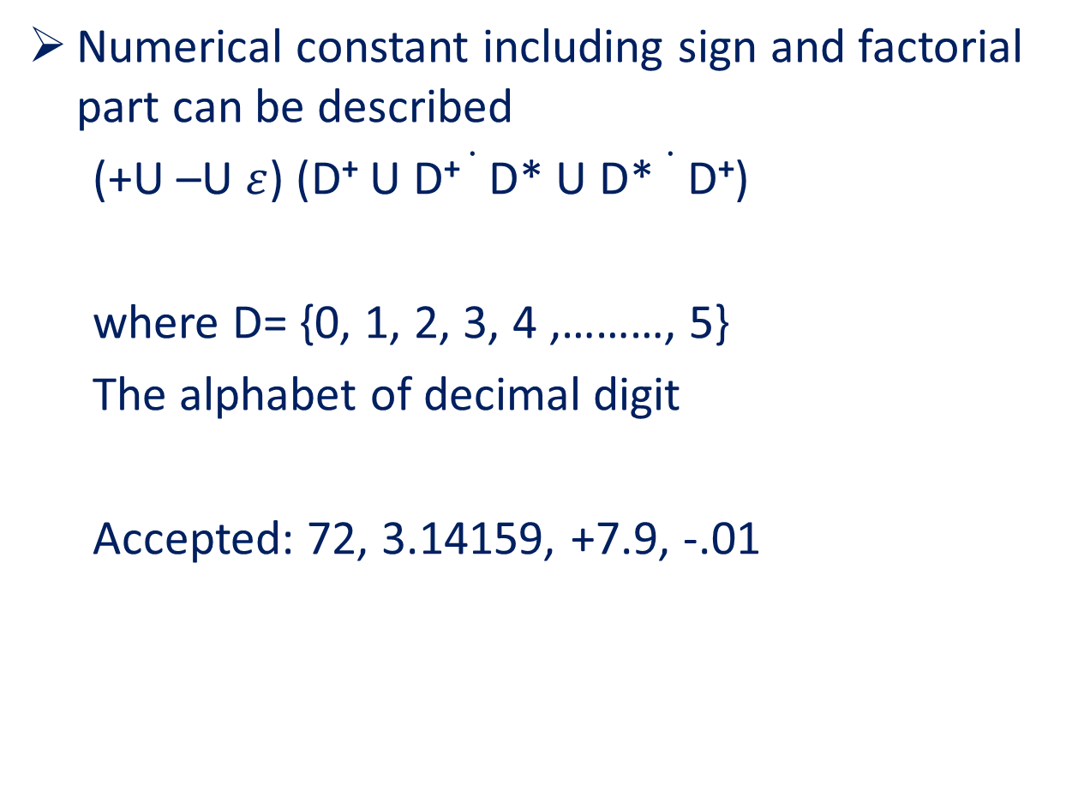
Application of Regular Expression (cont.)
Numerical constant including sign and factorial part can be described
(+U –U $ε$) (D⁺ U D⁺ $∙$ D* U D* $∙$ D⁺)
where D= {0, 1, 2, 3, 4 ,………, 5}
The alphabet of decimal digit
Accepted: 72, 3.14159, +7.9, -.01

Slide 18
Thank You

